Slide 1
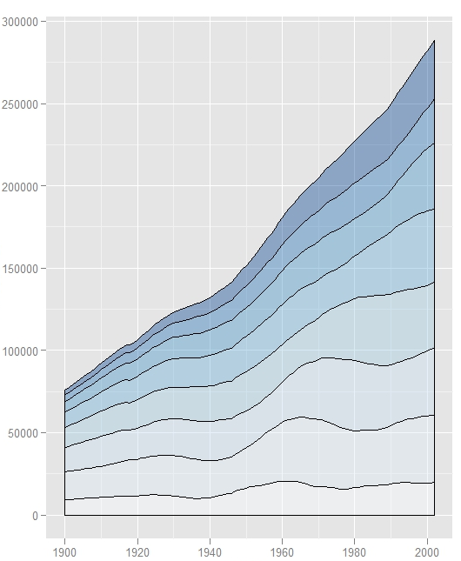
Introduction to ggplot2
Indy UseR group
05.19.2015
Matt Gilliam

Slide 2
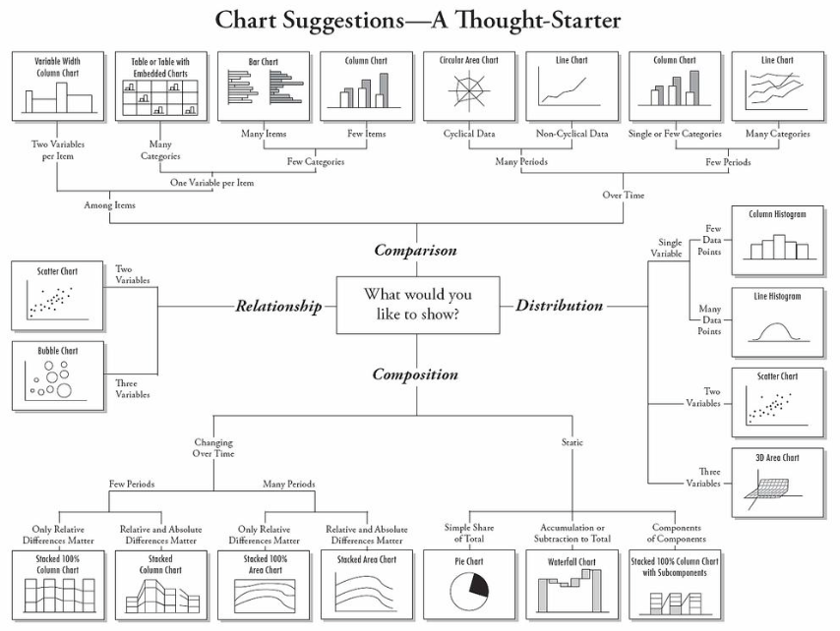

Slide 3
Base
“Artist’s palette” model
Start with blank canvas and build up from there
Start with plot function (or similar)
Use annotation functions to add/modify (text, lines, points, axis)
Pros:
Convenient, mirrors how we think of building plots and analyzing data
Cons:
Can’t go back once plot has started (i.e. to adjust margins);
need to plan in advance
Difficult to “translate” to others once a new plot has been created (no graphical “language”). Plot is just a series of R commands

Slide 4
Lattice
Plots are created with a single function call (xyplot, bwplot, etc.)
Pros:
Most useful for conditioning types of plots: Looking at how y changes with x across levels of z
Thinks like margins/spacing set automatically because entire plot is specified at once
Good for putting many many plots on a screen
Cons:
Sometimes awkward to specify an entire plot in a single function call
Annotation in plot is not intuitive
Use of panel functions and subscripts difficult to wield and requires intense preparation
Cannot “add” to the plot once it’s created

Slide 5
ggplot2
Pros:
Split the difference between base and lattice
Automatically deals with spacing, text, titles but also allows you to annotate by “adding”
Superficial similarity to lattice but generally easier/more intuitive to use
Default mode makes many choices for you (but you can customize!)

Slide 6
ggplot2
An implementation of the grammar of graphics in R.
It combines the advantages of both base and lattice graphics: conditioning and shared axes are handled automatically, and you can still build up a plot step by step from multiple data sources.
It also implements a sophisticated multidimensional conditioning system and a consistent interface to map data to aesthetic attributes.

Slide 7

Hadley Wickham
Chief Scientist at RStudio
Adjunct Assistant Professor of statistics at Rice University
John Chambers award in 2006
Widely used packages including ggplot2, plyr, dplyr, and reshape2

Slide 8
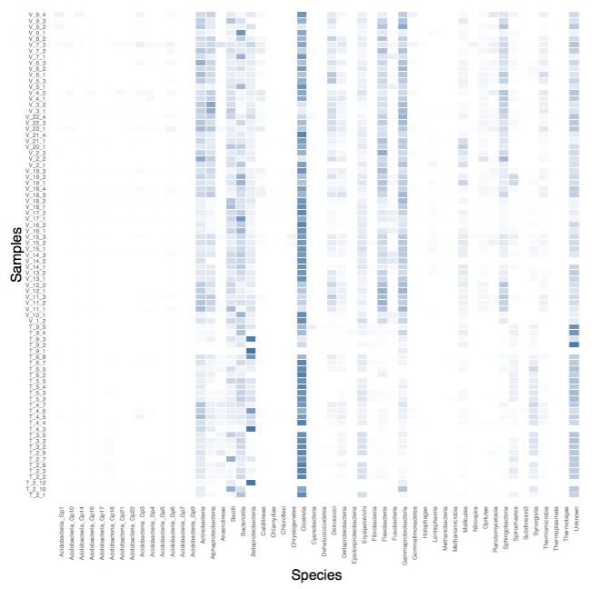
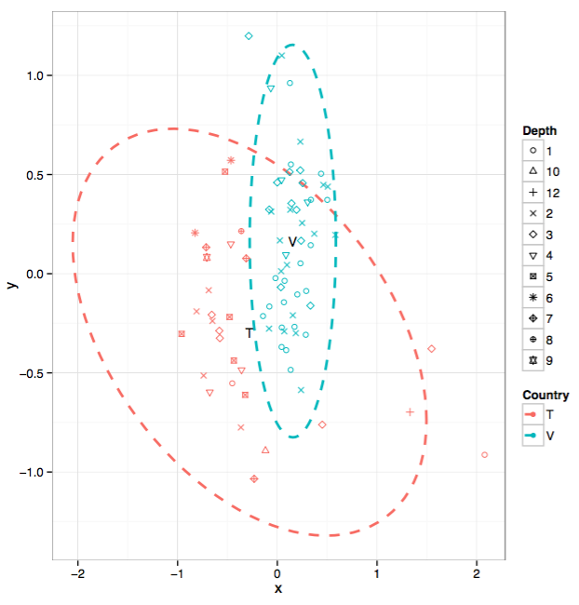
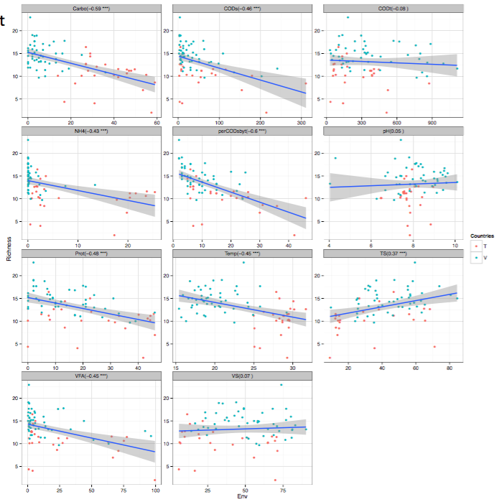
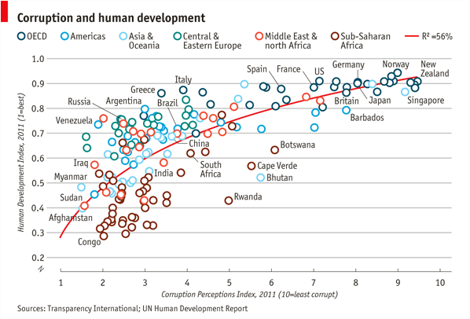

Slide 9
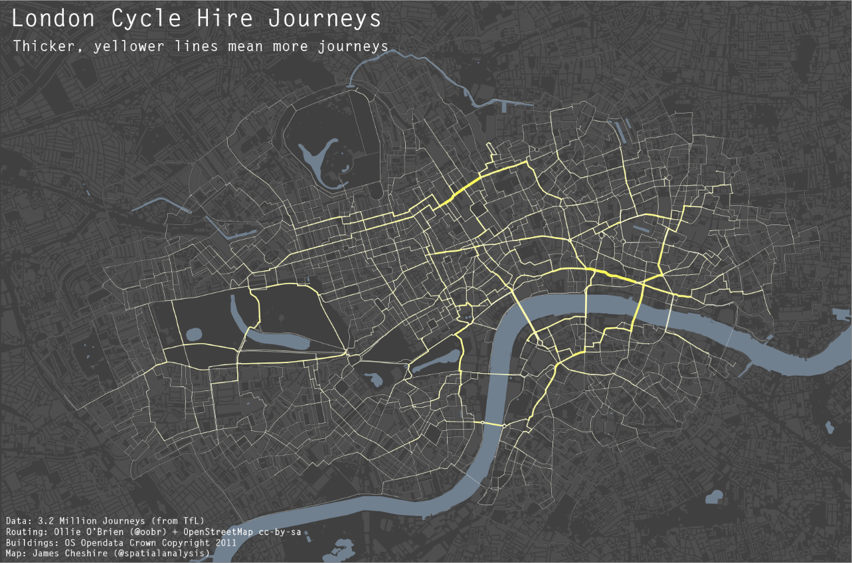

Slide 10
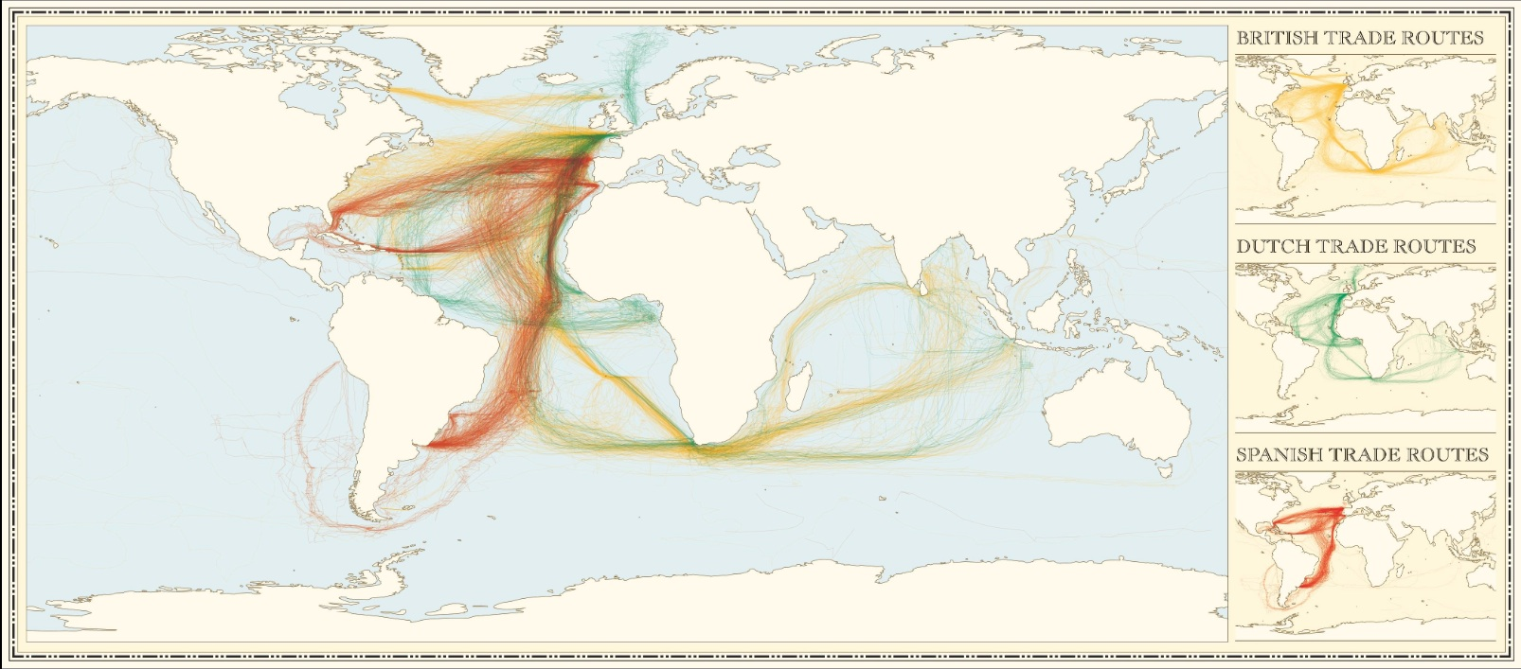

Slide 11
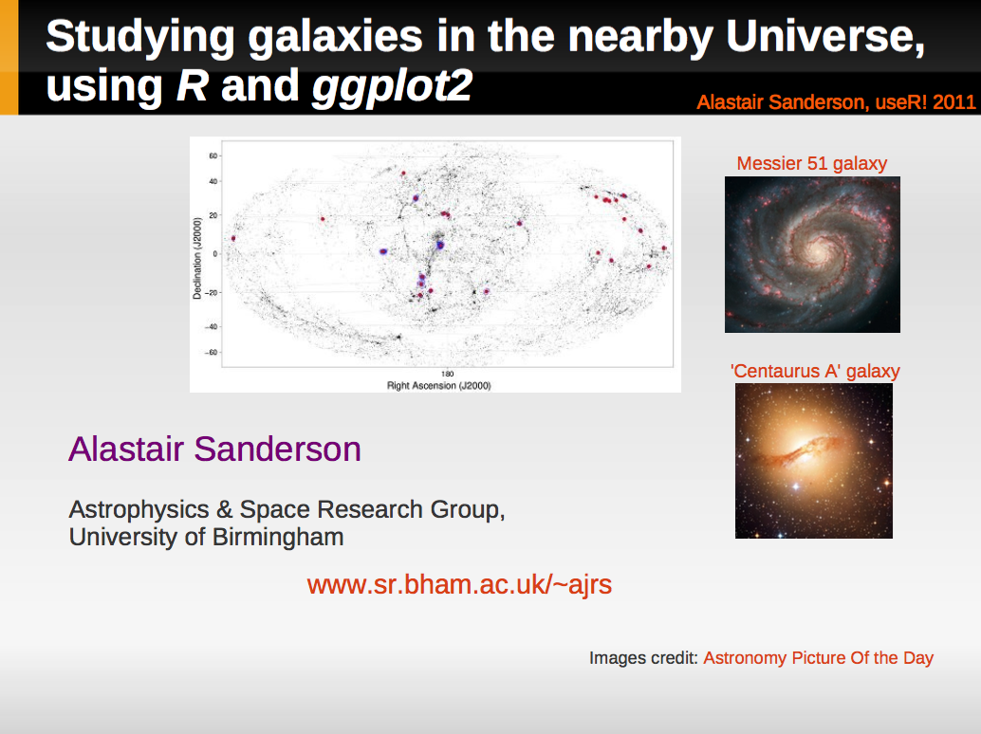

Slide 12
qplot
The workhorse function for basic plots in ggplot2 is qplot and has basic usage
qplot(x, ..., data, geom)
x: values of one variable of interest data: data frame geom: the type of plot to construct

Slide 13
ggplot components
a data frame
aesthetic mappings: how data are mapped to color, size
geoms: geometric objects like points, lines, shapes
facets: for conditional plots
stats: statistical transformations like binning, quantiles, smoothing
scales: what scale an aesthetic map uses (example: male = red, female = blue)
coordinate system

Slide 14
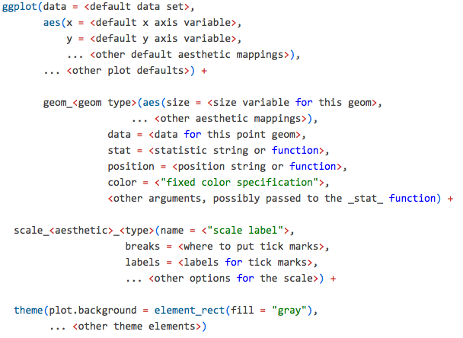

Slide 15
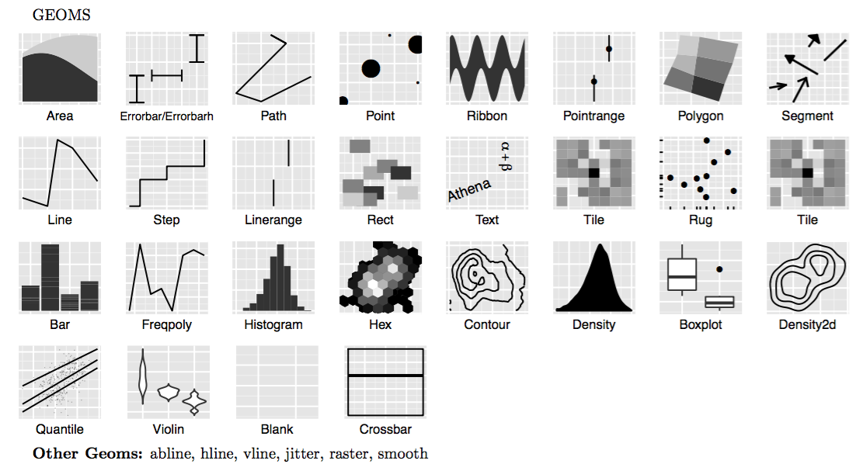
geom

Slide 16
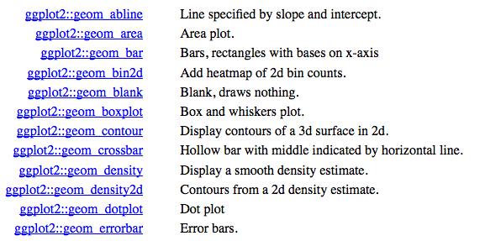
geom cont.

Slide 17
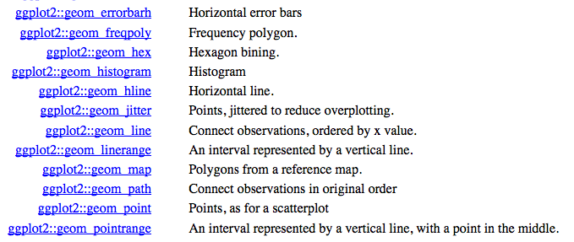

Slide 18
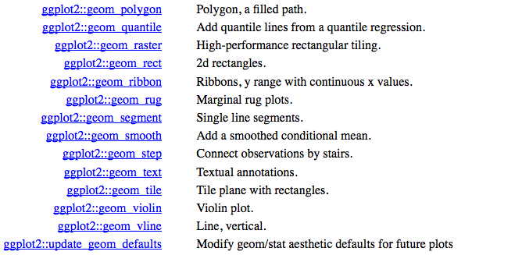

Slide 19
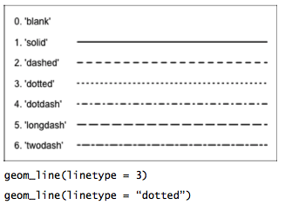
Points and line styles

Slide 20
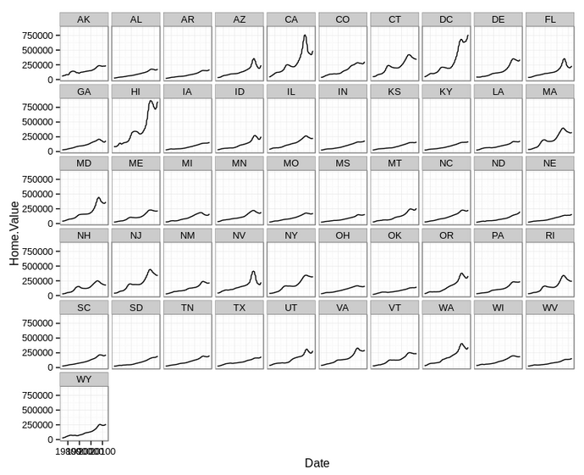
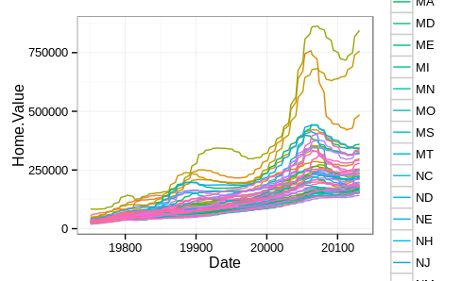
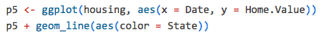
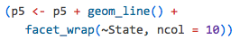
facets

Slide 21
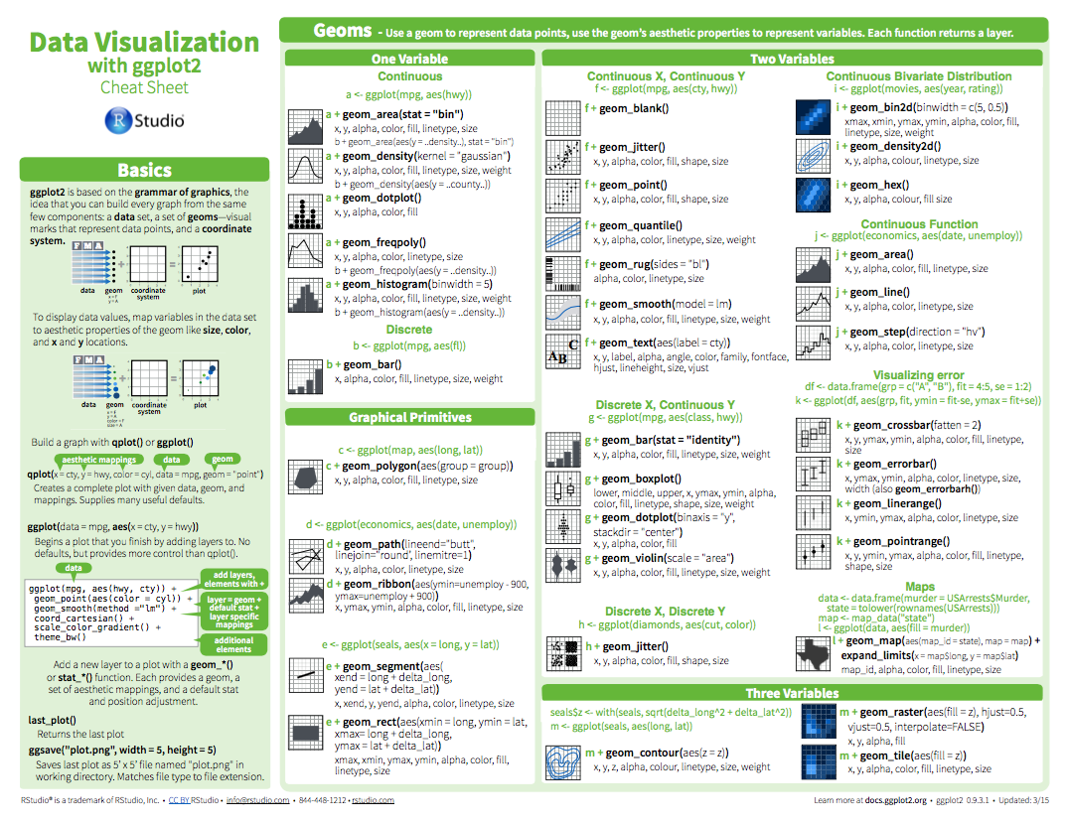

Slide 22
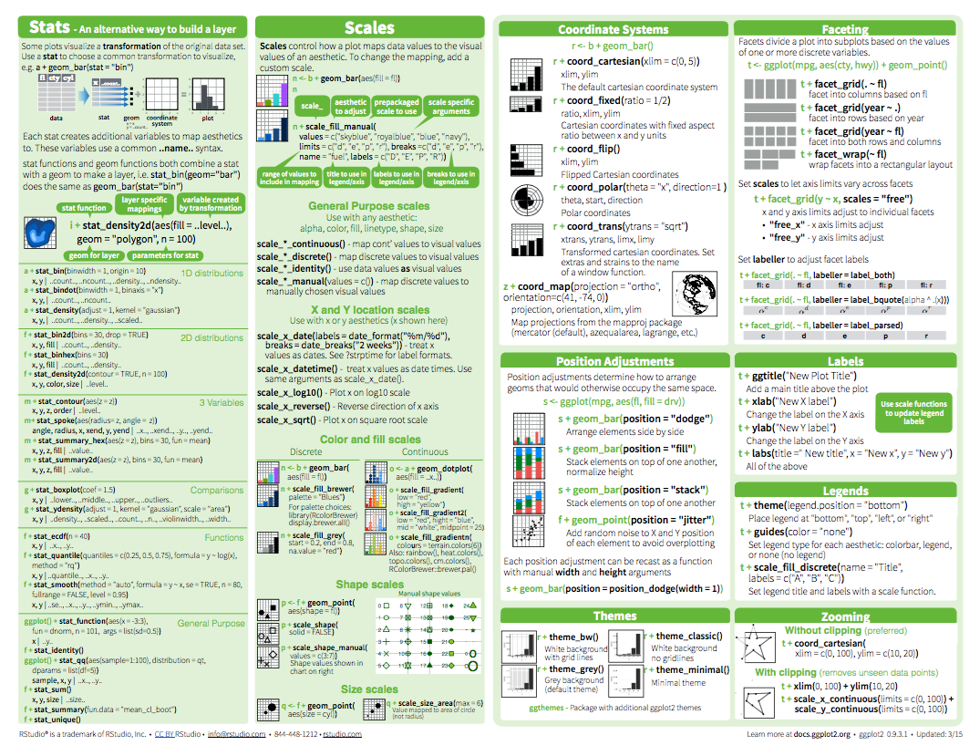

Slide 23
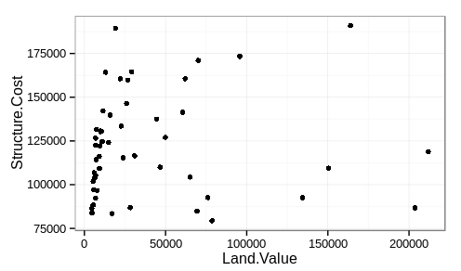
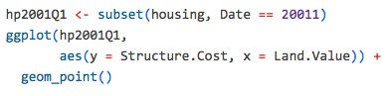

Slide 24
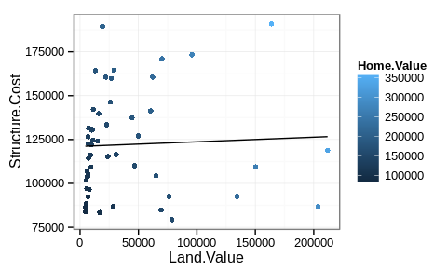
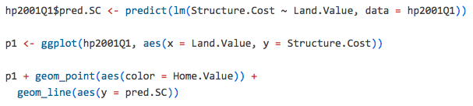

Slide 25
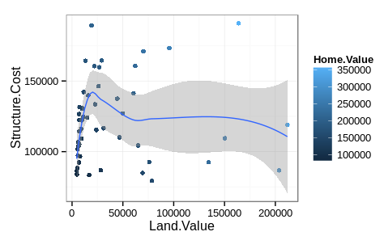
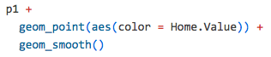

Slide 26
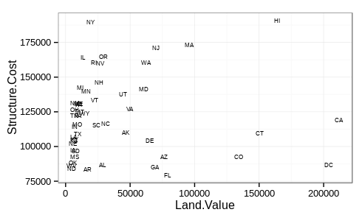
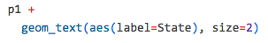

Slide 27
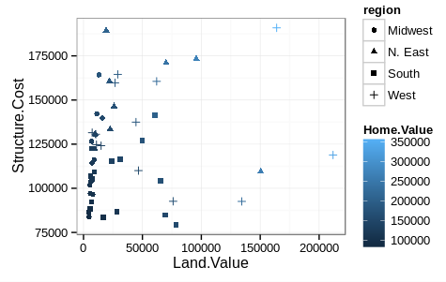
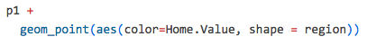

Slide 28
Saving Plots
Using the GUI, choose file → save
There are a few ways to save your plots in R.
png(filename, width, height)
pdf(file, width, height)
If the plot has already been rendered, then use
dev.copy(device, filename)
ggsave(filename, width, height)

Slide 29
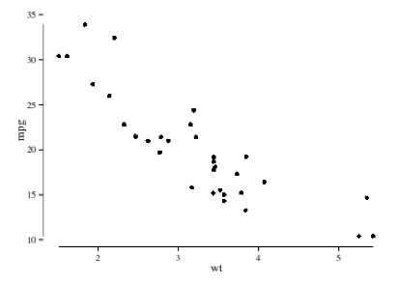
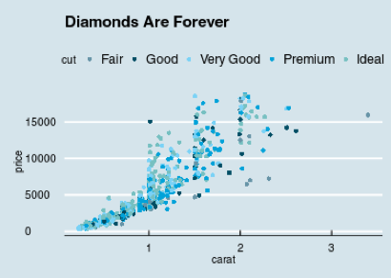
ggthemes
Some extra geoms, scales, and themes for ggplot
Tufte theme and geoms
Economist theme

Slide 30
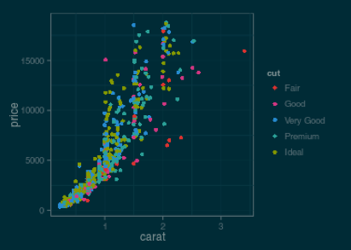
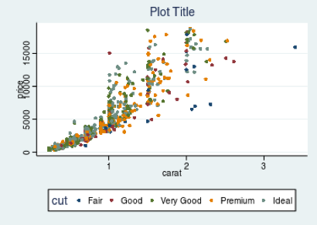
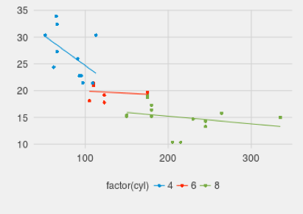
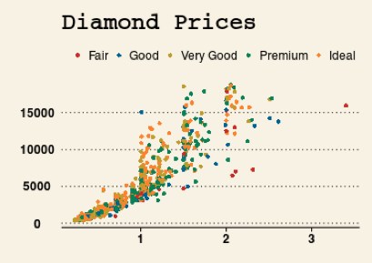
Solarized theme
Stata theme
Fivethirtyeight theme
Wall Street Journal theme

Slide 31
Resources
“ggplot2: Elegant graphics for data analysis” - Hadley Wickham
http://ggplot2.org/ (official website)
“The Grammar of Graphics (Statistics and Computing)” - Leland Wilkinson

